Slide 1
Culture, Equity and Outcome in Toronto Schools:
The Importance of Demographic Data!
Prepared by the Centre for Urban Schooling (OISE/UT)
Professor Lance McCready and Jeff Kugler
October 12, 2012
Notes:
The purpose of this presentation is to explore the issues connected to the use of demographic data within education. We cannot talk about creating equitable school systems without having as many facts as possible. One significant component is data. The data allows us to answer the question: “Who is the system working well for and for whom does the system need to change?” In order to begin to understand the nature of the gap we need to get a good sense of the data.
As we go through this slide presentation, we must be mindful of a few things:
There are many societal factors which impact student achievement. Many of which schools have little or no control over. However, we do know from research that effective teacher practice can make the greatest difference in terms of student achievement. We need to focus our energy and conversations on our locus of control.
Working to close the achievement gap requires adapting a different focus and lens, working differently, but not necessarily harder.
As we look at the data, we as educators know that almost all students regardless of demographic factors have the same capacity and potential for greatness academically and otherwise. Therefore, we explore this data with the lens that the problem is that of the system and not of the students.
How we view and use this data is directly tied to our fundamental beliefs about education, our students, their communities and how we understand issues of race and class within our society and within our educational context. We can either use the data to explore the need for system, school and pedagogical changes to improve outcomes and experiences for all students OR we can use this data to change nothing, as this data is a validation of the stereotypes we may hold about certain students and their lack of potential. It is our role to ensure that we all move forward with the first view.

Slide 2
The Ontario Human Rights Commission
“It is a common misperception that the Code prohibits the collection and analysis of data identifying people based on race and other Code grounds. Many individuals, organizations and institutions mistakenly believe that collecting this data is automatically antithetical to human rights…The OHRC’s position [is] that data collection and analysis should be undertaken where an organization or institution has or ought to have reason to believe that discrimination, systemic barriers or the perpetuation of historical disadvantage may potentially exist”. (OHRC 2009, pp.42-43)
Notes:
Although this data can provide ammunition for positive change in schools there are some who believe that collecting demographic information reinforces discrimination. In Ontario the OHRC has determined the opposite (Read Quote)
Bien que ces données peuvent fournir des munitions pour un changement positif dans les écoles, il y a certains qui croient que la collecte de données démographiques renforce la discrimination. En Ontario, la CODP a déterminé le contraire (citation Lire)

Slide 3
“Roots of Youth Violence”
McMurtry & Curling (2008) note the importance of (and resistance to) collection of data according to race. They state: “It is hard to think of another domain where it would be controversial to seek evidence of a problem and, where a problem is found, go on to seek evidence of how best to address it and whether the efforts made to do so are bearing fruit” (p. 240).
Notes:
Another Ontario support for demo data.
For the next group of slides we will be examining some of the ways that demographic data has been collected in the Toronto District School Board.
Un autre soutien en Ontario pour les données démographiques. (read slide))
Pour le prochain groupe de diapositives nous allons examiner quelques-unes des façons dont les données démographiques ont été recueillies dans le Toronto District School Board.

Slide 4
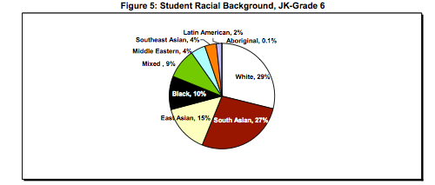
TDSB Racial Breakdown JK-6
2008 Parent Census, Kindergarten-Grade 6: System Overview and Detailed Findings-Janet O’Reilly and Maria Yau, February 2009
Notes:
Breaking down data by demographic characteristics, also known as disaggregating data, is a fairly new practice in Canada. However, it is an essential practice that can help to shine the light on issues that we must address as a school system that is trying to be equitable to all learners.
For our first slide….Who is sitting in othe classrooms? What does othe system look like by racial background? (REFER TO SLIDE—in particular 29% white)
For the purposes of TDSB data collection and analysis, the groups are defined as follows:
South Asian: India, Pakistan, Bangladesh, Sri Lanka, Guyana, and Trinidad
East Asian: China, Hong Kong, Korea, and Japan
Southeast Asian: Vietnam, Cambodia, Laos, and the Philippines
Black: Caribbean, African and Multi-generational Canadian born
Middle Eastern: Iran, Iraq, Afghanistan
Latin American: Spanish speaking/Latino/a
White: Predominantly of European descent
Ventiler les données selon les caractéristiques démographiques, est une pratique relativement nouvelle au Canada. Cependant, il est une pratique essentielle qui peut aider à briller la lumière sur les questions que nous devons aborder comme un système scolaire qui est d'essayer d'être équitable à tous les etudiants. Pour notre première diapositive .... Qui est assis en classe? Qu'est-ce que le système ressemblent par origine raciale?
(Pour le TDSB les groupes sont définis comme suit: Asie du Sud: Inde, Pakistan, Bangladesh, Sri Lanka, en Guyane et à la Trinidad Asie de l'Est: Chine, Hong Kong, la Corée et le Japon Du Sud-Est asiatique: le Vietnam, le Cambodge, le Laos et les Philippines Noir: des Caraïbes, d'Afrique et multi-générationnelle nées au Canada Moyen-Orient: Iran, Irak, Afghanistan Amérique latine: hispanophone / latino / a Blanc: Principalement d'origine européenne

Slide 5
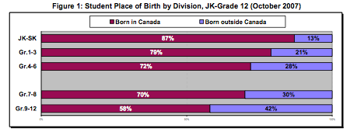
TDSB Data, 2008 Parent Census
Notes:
Based on the Board’s October 2007 enrolment figures, the majority of the student population are Canadian-born, but the proportions are much higher in the younger grades (e.g., 87% for the kindergarten division) than in the more senior grades (e.g., 72% for the junior level, and 58% in the secondary school panel). There are more foreign-born students at the higher than at the lower grade levels.
Basé sur le nombre d'inscriptions en octobre 2007 et, la majorité de la population étudiante sont nés au Canada, mais les proportions sont beaucoup plus élevés pour les plus jeunes (par exemple, 87% pour la maternelle) que dans les classes plus âgées (par exemple, 72 % pour le niveau junior, et 58% dans le panneau de l'école secondaire)

Slide 6
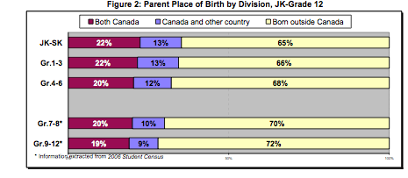
TDSB Data, 2008 Parent Census
Notes:
Among the JK-Grade 6 population, only about one fifth of students have two Canadian-born parents. For the remaining majority (about 80%), either both or one of their parents are immigrants from such countries as China, India, Sri Lanka, Pakistan, Jamaica, Guyana, and Vietnam. In other words, a large proportion of the student population are from immigrant families. This pattern for the JK- Grade 6 students is similar to that of their senior and secondary counterparts, except that the latter has an even higher percentage of parents who are immigrants.
Parmi les JK-12 année de la population, environ un cinquième seulement des élèves ont deux parents nés au Canada. Pour la majorité restante (environ 80%), soit les deux, ou l'un de leurs parents sont des immigrants. En d'autres termes, une grande partie de la population étudiante sont issus de l'immigration

Slide 7
TDSB Data, 2008 Parent Census
Notes:
In terms of home languages –i.e., language spoken at home, there is a clear proportionate shift over time among those whose first language is neither English nor French. For instance, while 41% of the JK-Grade 6s first learned a language other than English, by the time they attend school, the proportion who only speak their first language at home drops to 33% by the kindergarten level and to 29% by the junior level. Instead, there is a steady increase from 16% who first learned both English and another language at home to 24%-27% who have become bilingual speaking both English and their own mother tongue(s).
En termes de langue maternelle,

Slide 8
2008 Parent Census, Kindergarten-Grade 6: System Overview and Detailed Findings-Janet O’Reilly and Maria Yau, February 2009
Notes:
Of the five income categories listed in the survey, the lowest income group (less than $30,000) was reported by the largest portion of parents (27%). This income level is below the lowest income cut-off (LICO, $34, 572) set by Statistics Canada for a family of four in a large metropolitan area like Toronto. The next lowest income category ($30,000-$49,999) was reported by nearly a quarter of the parents (23%). These two groups combined constitute 50% of the population. That is, half of the JK-Grade 6 population are from lower income families…..the income gap between Toronto’s rich areas and poor areas is growing, while its middle-income neighbourhoods are disappearing. (p.18)
Parmi les cinq catégories de revenus énumérées dans l'enquête, le groupe de revenu le plus faible (moins de $ 30.000) a été rapportée par la plus grande partie des parents (27%). Ce niveau de revenu est inférieur au revenu le plus faible de coupure (SFR, 34 $, 572) établi par Statistique Canada pour une famille de quatre personnes dans une grande région métropolitaine comme Toronto. La catégorie de revenu inférieur le plus proche (30.000 $ - 49.999 $) a ​​été rapportée par près d'un quart des parents (23%). Ces deux groupes combinés constituent 50% de la population. Autrement dit, la moitié des etudiants de la maternelle à la 6e année proviennent de familles à faible revenu ..... l'écart de revenu entre les régions riches et les régions de Toronto pauvres est de plus en plus grand, tandis que les quartiers à revenu intermédiaire sont en train de disparaître. (p.18)

Slide 9
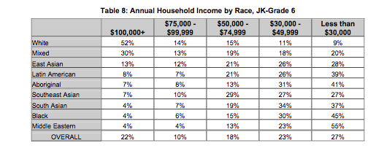
2008 Parent Census, Kindergarten-Grade 6: System Overview and Detailed Findings-Janet O’Reilly and Maria Yau, February 2009
Notes:
White students are the only group with the majority coming from families earning over $100,000 annually (the highest income category defined in the survey). For the other racial groups, only a small minority are in the higher income brackets combined. Except for the White and Mixed groups, the majority of all other racial groups are within the two lower income categories. Indeed, among the Middle Eastern and Black students, about half are from the lowest income bracket (less than $30, 000) (p.20)
Les étudiants blancs sont le seul groupe dont la majorité venant de familles gagnant plus de 100.000 dollars par an (la catégorie la plus élevée définie dans l'enquête). Pour les autres groupes raciaux, seule une petite minorité sont dans les tranches de revenus les plus élevés combinés. En effet, parmi les étudiants du Moyen-Orient et noir, environ la moitié sont de la tranche inférieure de revenu (moins de 30 $, 000) (p.20)

Slide 10
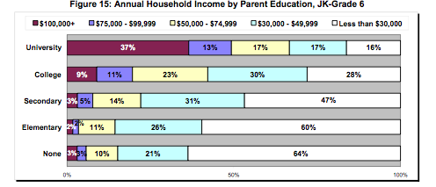
TDSB Research Report: 2008 Parent Census, Kindergarten-Grade 6: System Overview and Detailed Findings-Janet O’Reilly and Maria Yau, February 2009
Notes:
Regarding parent education background…the data illustrates a linear relationship between parents’ educational levels and their household income levels. That is, the higher educational level, the higher are their household incomes. For students with at least one parent with a university degree, half (50%) are from the two higher income groups. This percentage however drops to 20% for those whose parents have a college education; indeed, for these students, a large majority are in the two lower income categories.
En ce qui concerne l'éducation des parents ... les données montre une relation linéaire entre le niveau d'éducation des parents et de leurs niveaux de revenu. Autrement dit, le plus le niveau d'instruction, le plus élevé sont les revenus de familles.

Slide 11
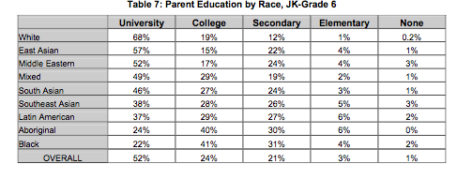
TDSB Research Report: 2008 Parent Census, Kindergarten-Grade 6: System Overview and Detailed Findings-Janet O’Reilly and Maria Yau, February 2009
Notes:
White students have the highest proportion (68%) with one or both of their parents having a university degree, followed by East Asian (57%) and Middle Eastern (52%) students. On the other hand, Black and Aboriginal students have the lowest proportion (22% and 24% respectively) of parents with a university education.
Les étudiants blancs ont la plus forte proportion (68%) avec un ou deux parents ayant un diplôme universitaire, suivie par l'Asie (57%) et du Moyen-Orient (52%) des étudiants. D'autre part, les étudiants noirs et autochtones ont la plus faible proportion (22% et 24% respectivement) des parents ayant une formation universitaire.

Slide 12
Special Education By Racial Background
Notes:
Table 3 compares students self-identified racial groups. Within the 2006 Student Census, students were asked to self-identify by race. The last row of Table 3 indicates the proportion of all students within each racial category. Across categories important racial trends emerge. Certain racial groups are over-represented in specific exceptionality categories. International literature indicates that the proportion of impairment within a racial group should mirror the overall representation within the population.
Dans le cadre du Recensement de 2006 étudiants, les étudiants ont été invités à s'identifier par race. La dernière ligne du tableau 3 indique la proportion de tous les élèves au sein de chaque catégorie raciale. Dans toutes les catégories des tendances raciales importantes émergent. Certains groupes raciaux sont surreprésentés dans les catégories exceptionnel spécifiques. La littérature internationale montre que la proportion de gens au sein d'un groupe racial en termes de l’education speciale doit refléter la représentationdu groupe au sein de la population.

Slide 13
Triangulation-3 sources Adapted from the National Center for School Counseling Outcome Research
School and Classroom Data
Standardized Results Data
Problem
Perceptual Data
Notes:
When exploring data and how or WHY we should use it in our practice, it is important to look at more than one source to find out if the issue you think is an issue is REALLY an issue. You need to explore multiple sources:
Standardized Results Data: We recognize that standardized testing has limitations and biases. However, it is one source of information that we need to look at. For example: EQAO tells us one story…is that story supported by other sources?
What does School and Classroom Data tell us: What do grades look like? How do students perform on teacher created assessments? What does daily performance look like? Additionally, what about suspensions, attendance, office referrals, etc. What story does that tell? Does it support what you found from the standardized data? Does it tell a similar story?
What about the Perceptual Data? This is what the students have to say…this is what their feeling in the classes and in the schools…this is how they see their ability to achieve and be excellent academically…this is how supported they are in their academic journey? Does what they have to say support what the other data tells us?
When these circles of data support each other, we can conclude that there is a problem. In our system, do these circles support that there is a concern?
There is no data that looks to teacher practice or the impact of community and parent in-put.
Alpha
Lors de l'exploration de données et comment et pourquoi nous devrions l'utiliser dans notre pratique, il est important de regarder plus d'une source de savoir si la question vous semble un problème est vraiment un problème. Vous avez besoin d'explorer des sources multiples: Normalisés de données de résultats: Nous reconnaissons que les tests normalisés a des limites et des biais. Cependant, il est une source d'information que nous avons besoin de regarder. Par exemple: l'OQRE nous raconte une histoire ... c'est que l'histoire soutenue par d'autres sources? Qu'est-ce que l'école et la classe de données nous disent: Qu'est-ce que les grades ressembler? Comment puis aux élèves d'effectuer des évaluations des enseignants créés? Qu'est-ce que la performance quotidienne ressembler? En outre, qu'en est-il des suspensions, la fréquentation, les renvois de bureau, etc Quelle histoire que dire? Est-il d'accord avec ce que vous avez trouvé à partir des données standardisées? Est-ce qu'il raconte une histoire semblable? Qu'en est-il des données perceptuelles? C'est ce que les étudiants ont à dire ... c'est ce que leur sentiment dans les classes et dans les écoles ... voilà comment ils voient leur aptitude à atteindre et être excellent académiquement ... voilà comment ils sont pris en charge dans leur parcours scolaire? Est-ce qu'ils ont à dire ce soutien les autres données nous dit? Lorsque ces cercles de données se soutenir mutuellement, nous pouvons conclure qu'il ya un problème. Dans notre système, ces cercles ne supporte qu'il ya un problème? Il n'existe pas de données qui ressemble à la pratique enseignante ou l'impact de la communauté et des parents en mettre.

Slide 14
Triangulation-3 sources
57% of Black students score in Level 1 and 2 in 3rd grade reading on EQAO
57% of 7th and 8th grade Black students score in Level 1 and 2 based on grades
Problem
ALL Grade 7 and 8
Level 1 and 2 students (based on grades) when asked how comfortable they are with the overall school environment-48% of the time they responded “rarely/never”
Notes:
So for example if we look at this slide we can see an example of the triangulation of data supporting the existence of a problem.
Standardized data: (READ) 57%....................
School based data: (READ) 57%...................
Perceptual data: (READ) ALL Grade 7 and 8 Level 1 students………….
There is a big problem!!!
Ainsi, par exemple si l'on regarde cette diapositive, nous pouvons voir un exemple de la triangulation des données démontrant l'existence d'un problème. Les données normalisées: (READ) 57% .................... Ecole fondée données: (READ) 57% ................... Données perceptives: (LIRE) les 7 et 8 e année de niveau 1, les élèves ............. Il ya un gros problème!

Slide 15
Achievement Outcome Measures: Percentage Marks converted to Achievement Levels
Level 1 and R: Below standard and extensive remediation is required (50-59%)
Level 2: Approaches the provincial standard (60-69%)
Levels 3 & 4: Meets and exceeds the provincial standard (70-80% and 80-100%)
TDSB Research Report: 2006 Student Census: Linking Demographic Data with Student Achievement, Robert S. Brown and Erhan Sinay, April 2008 and Ontario Curriculum Achievement Charts (Draft)
Notes:
When looking at the data on some of the coming charts, we want to clarify the levels that refer to student outcomes in schools….The levels above explain the achievement of the students (READ THE CHART)
Lorsque l'on regarde les données sur certaines de ces cartes à venir, nous voulons clarifier les niveaux qui se réfèrent aux résultats des élèves dans les écoles .... Les niveaux ci-dessus expliquent la réalisation des élèves (lire le tableau)

Slide 16
Questions to think about……..
Overall what are your reactions to drawing on demographic data to advance equity work? (challenges and opportunities)
What are some new questions which come from looking at the data?
How might this data have implications for educational researchers and policy makers?
Is there comparable demographic data available from your school boards?
Notes:
Each group will now be given some data slides to explore….Data that reflects the TDSB system. When you receive your charts, work in groups to answer the following questions: (READ THE SLIDE) After a few minutes, we will have each group share their responses and we will share all of the data collectively.
Chaque groupe va maintenant donner quelques diapositives de données à explorer .... Données qui reflète le système TDSB. Lorsque vous recevez vos cartes, le travail en groupes pour répondre aux questions suivantes: (lire la diapositive) Après quelques minutes, nous aurons chaque groupe de partager leurs réponses et nous allons partager toutes les données collectivement.

Slide 17
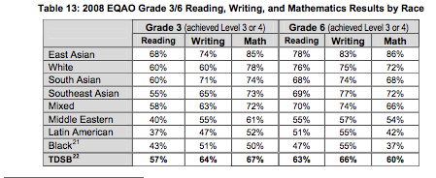
TDSB Research Report: 2008 Parent Census, Kindergarten-Grade 6: System Overview and Detailed Findings-Janet O’Reilly and Maria Yau, February 2009
Notes:
Group 1

Slide 18
TDSB Research Report: 2008 Parent Census, Kindergarten-Grade 6: System Overview and Detailed Findings-Janet O’Reilly and Maria Yau, February 2009
Notes:
Group 1

Slide 19
TDSB Research Report: 2006 Student Census: Linking Demographic Data with Student Achievement, Robert S. Brown and Erhan Sinay, April 2008
Notes:
Group 2

Slide 20
TDSB Research Report: 2006 Student Census: Linking Demographic Data with Student Achievement, Robert S. Brown and Erhan Sinay, April 2008
Notes:
Group 2

Slide 21
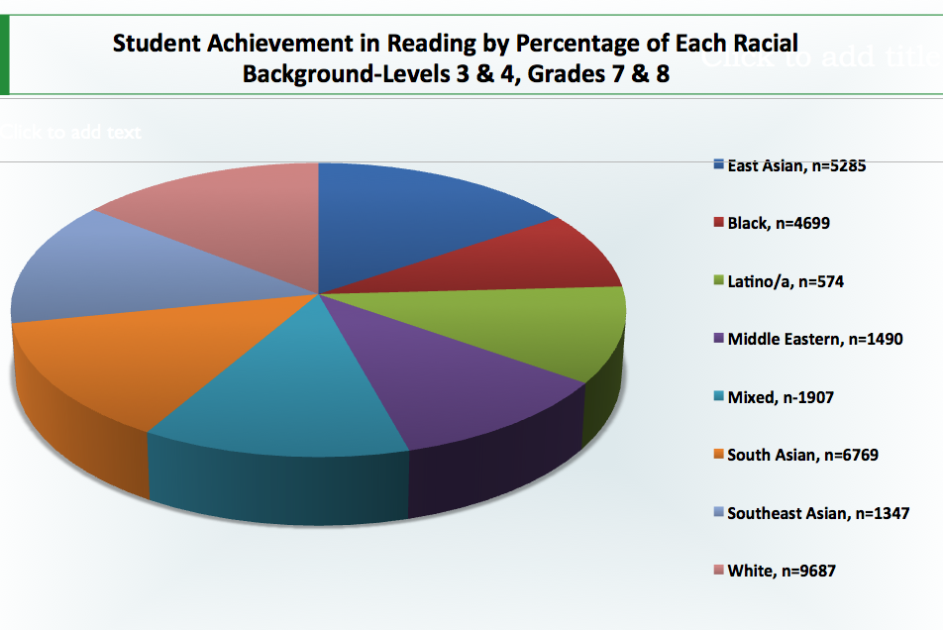
Notes:
Groups 2

Slide 22
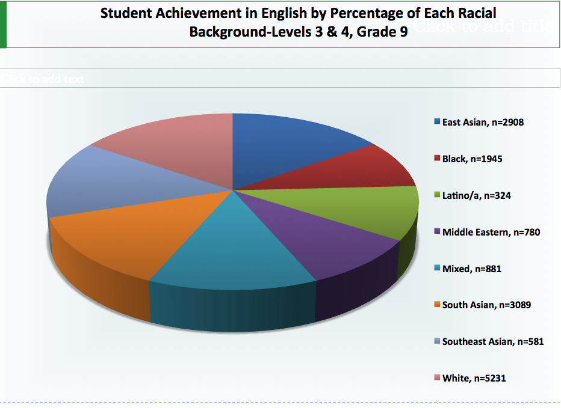
Notes:
Group 2

Slide 23
Student Achievement of Self-Identified Black Students in Reading and Writing-Grade 7 & 8
White 8% 20% 72% 9687 9% 20% 71%
TDSB Research Report: 2006 Student Census: Linking Demographic Data with Student Achievement, Robert S. Brown and Erhan Sinay, April 2008
Notes:
Group 3

Slide 24
Student Achievement of Self-Identified Black Students in Mathematics and Science-Grade 7 & 8
White
13%
21%
66%
9698
14%
21%
65%
9646
TDSB Research Report: 2006 Student Census: Linking Demographic Data with Student Achievement, Robert S. Brown and Erhan Sinay, April 2008
Notes:
Group 3

Slide 25
Student Achievement of Self-Identified Black Students in Mathematics and Science-Grade 9
White 30% 22% 48% 5231 25% 22% 54% 5231
TDSB Research Report: 2006 Student Census: Linking Demographic Data with Student Achievement, Robert S. Brown and Erhan Sinay, April 2008
Notes:
Group 3

Slide 26
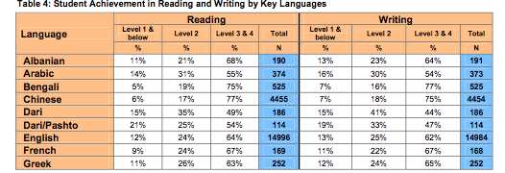
TDSB Research Report: 2006 Student Census: Linking Demographic Data with Student Achievement, Robert S. Brown and Erhan Sinay, April 2008
Notes:
Group 4

Slide 27
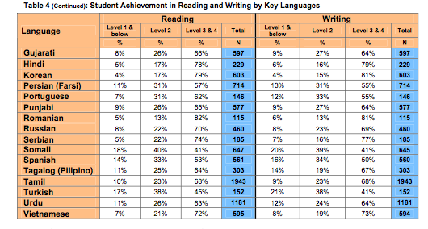
TDSB Research Report: 2006 Student Census: Linking Demographic Data with Student Achievement, Robert S. Brown and Erhan Sinay, April 2008
Notes:
Group 4

Slide 28
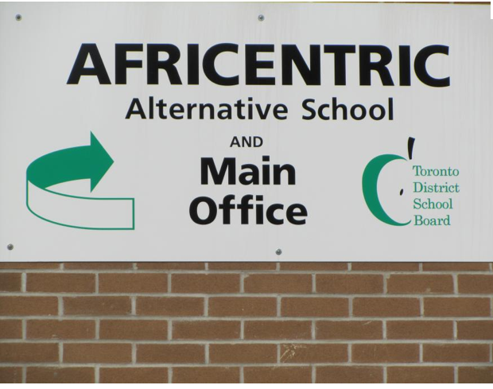
Demographic Data Supporting Community Activism
Africentric School
Notes:
In 2009 after many years of community struggle the TDSB opened the first Africentric School. Black parents and community members had for years been fighting the school board to do something to create more equitable outcomes for their children. Data had been released in 2006 which showed that 42% of students born in the English-Speaking Caribbean were being pushed out of secondary school. This data became an important of the argument advocating for an Africentric School.
En 2009, après plusieurs années de lutte communautaire du TDSB a ouvert la première école afrocentrique. Parents noirs et membres de la communauté avaient été pendant des années la lutte contre la commission scolaire de faire quelque chose pour créer des résultats plus équitables pour leurs enfants. Les données ont été libérés en 2006 qui a montré que 42% des élèves nés dans le pays anglophones des Caraïbes ont été poussés hors de l'école secondaire. Ces données est devenu un important argument plaidant pour une école afrocentrique.

Slide 29
Proyecto Latino
Notes:
In 2008 members of the Latino community in Toronto approached the Centre for Urban Schooling to explore the reasons for the 40% push out rate of Spanish-speaking students in Toronto. These discussions led to the creation of Proyecto Latino a collaborative research project that explores how Latino/a students explain the factors that influence their experiences. The popularity of the research project with Latino/a youth led to the research project becoming an on-going credit course in Spanish where students continue to engage in Participatory Action Research projects exploring their own experiences.
En 2008, les membres de la communauté latino-américaine à Toronto approché le Centre d'enseignement urbaine d'explorer les raisons pour les 40% de taux de pousser élèves hispanophones de Toronto. Ces discussions ont abouti à la création de Proyecto Latino un projet de recherche collaboratif qui examine comment Latino / a aux élèves d'expliquer les facteurs qui influencent leurs expériences. La popularité du projet de recherche avec des Latino / un jeune a conduit au projet de recherche devient un parcours de crédit en cours en espagnol où les élèves continuent à s'engager dans des projets de recherche-action participative qui explorent leurs propres expériences.

Slide 30
For TDSB Research Reports
http://www.tdsb.on.ca/_site/ViewItem.asp?siteid=172&menuid=28147&pageid=24206

